Slide 1
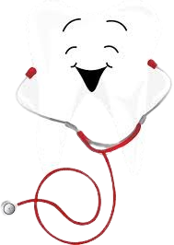
SmileTrack: A Smart Dental Clinic Management System
Name : Pronob Karmoker
BSSE 1431,
Rifat Ahmed Tushar
BSSE 1451
Supervised by
Dr. Emon Kumar Dey

Slide 2
MOTIVATION
1.Personal Relevance & Family Impact
2.Enhanced Patient Experience
3.AI-Powered Patient Assistance

Slide 3
Project Description
1.User Management
2.Patient Management
3. Appointment Scheduling
4.Dental Procedure & Treatment Tracking
5.Billing & Payment System
6. Staff Management
7.Notifications & Alerts
8.Patient Feedback System
9. AI-Powered Dental Chatbot for Patient Assistance

Slide 4
Languages or Tools
1.HTML
2. CSS
3.JavaScript
4.React.js
5.Node.js
6.Express.js
7. Mongoose
8.MongoDB
9.Git, GitHub
10.Visual Studio Code

Slide 5
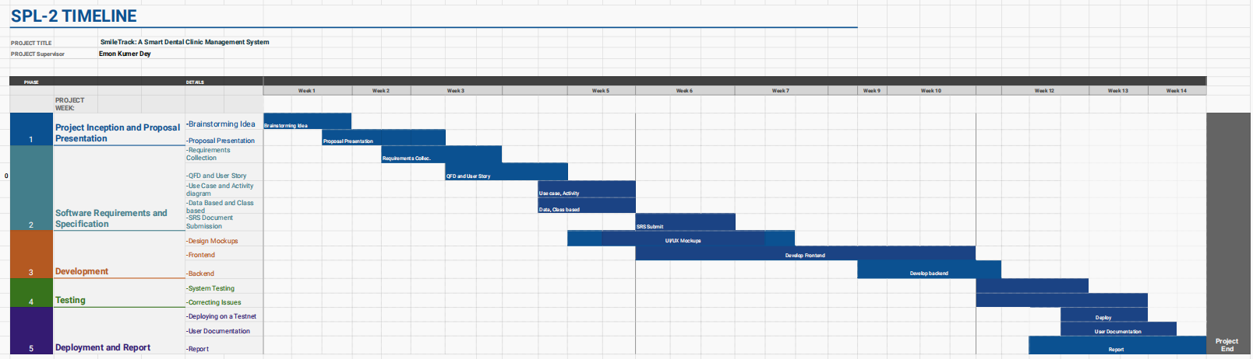
TIMELINE

Slide 6
Thank You

